Slide 1
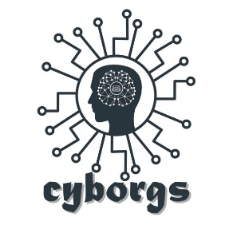


Code Off Duty
Team Name : Cyborgs
Problem Statement::- Build a mobile app for Mysuru tourism
Project Name : Mysuru Smart Tourism
Team Leader :- Rahul Pawar
Team Member :- Saurabh Lande
Onkar Tayde
#Lets Wow

Slide 2
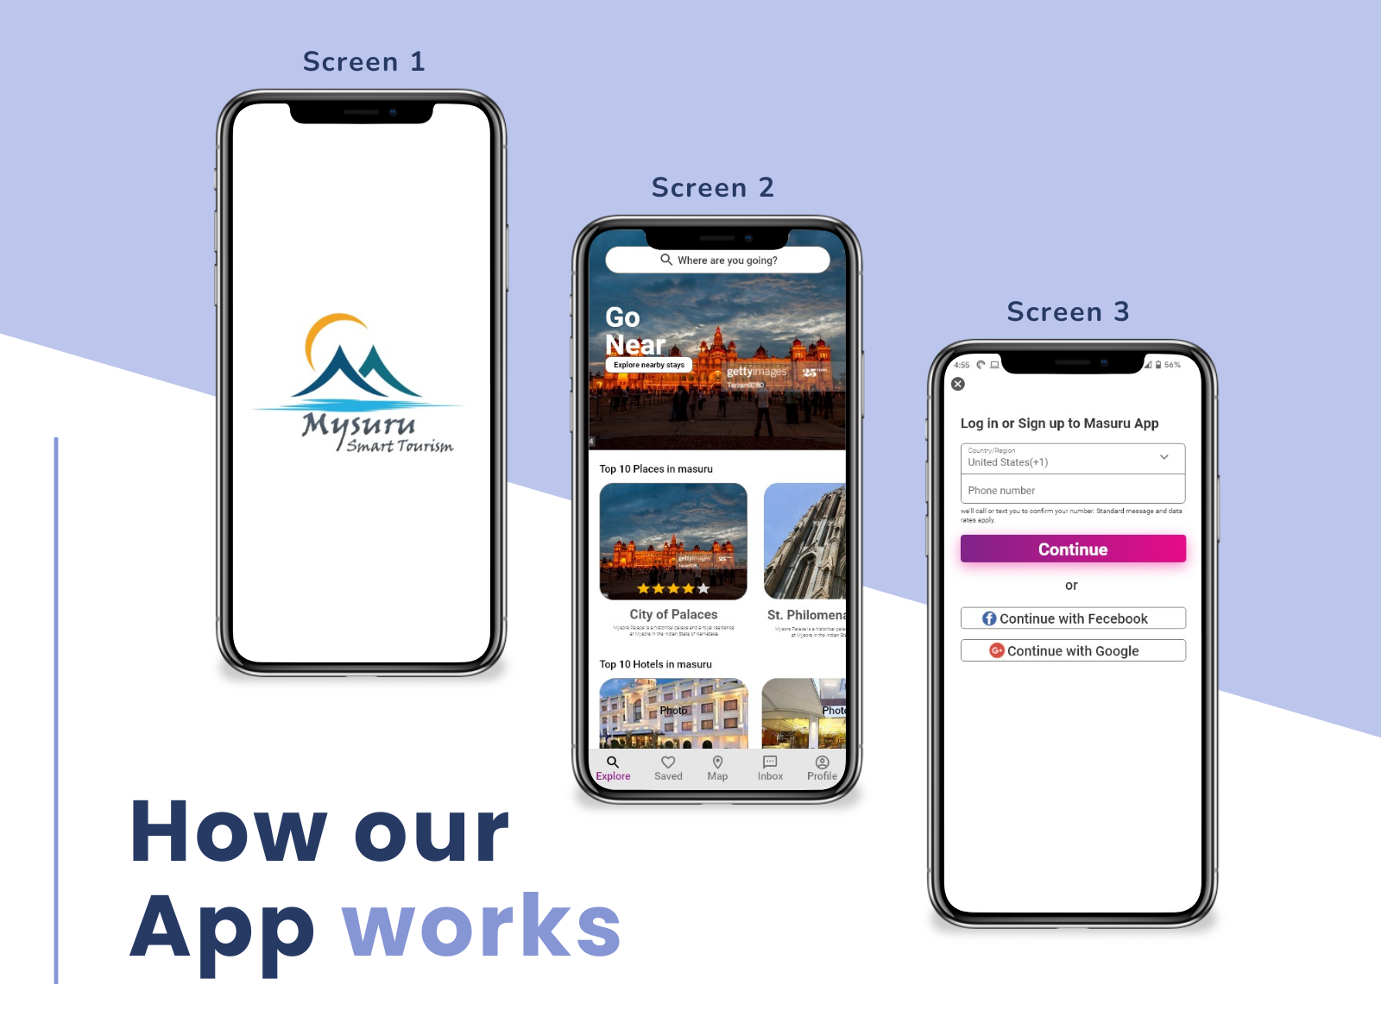
Solution/Approach
1. Created the android application called Mysuru Smart Tourism Application.
2. Mysuru Smart Tourism application is tourist guide application which can help the tourist find best places, hotels, and destinations.
3. Mysuru Smart Tourism app has 4 basic functionality such as Places , Hotels, Medical Support and Transportation.
4. In the application we have used the google maps api provide the easy map access for the user to find the nearby places.
5. Mysuru smart tourism app is connected with firebase Realtime database and Fire Storage to store the information's such as name of places, best time to visit, descriptions, images etc.
6. Tourist can get the transport and medical support in the app with help of third-party app integrations.
7. Integrating the TensorFlow Lite model to Recognised the places snapshot by tourist . Model can help tourist to find the places with smart computer vision and neural network.

Slide 3
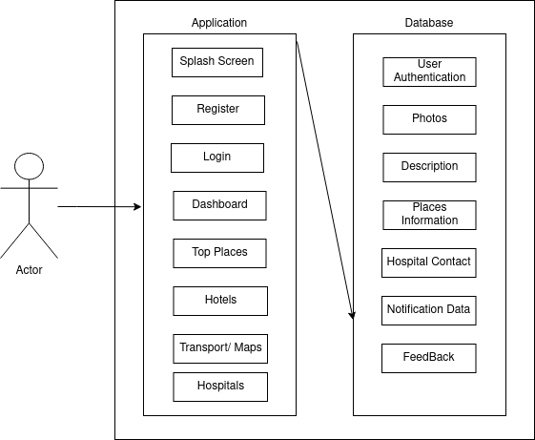
Mysuru Smart Tourism
Technical Stack
Android Studio
TensorFlow lite
DialogueFlow
Google Maps API
Fire Storage API
Firebase DB
Adobe XD
Heroku / GCP

